Slide 1
Grouping of Data
Prof. Sonia F. Panesar
Department of Computer Sci. & Eng.
Babaria Institute of Technology

Slide 2
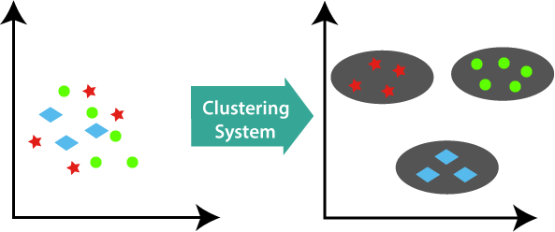
Clustering

Slide 3
Clustering basics
“Clustering is the task of dividing the population or data points into a number of groups such that data points in the same groups are more similar to other data points in the same group than those in other groups”.
"A way of grouping the data points into different clusters, consisting of similar data points. The objects with the possible similarities remain in a group that has less or no similarities with another group."

Slide 4
It does it by finding some similar patterns in the unlabelled dataset such as shape, size, color, behavior, etc., and divides them as per the presence and absence of those similar patterns.
It is an unsupervised learning method, hence no supervision is provided to the algorithm, and it deals with the unlabeled dataset.
After applying this clustering technique, each cluster or group is provided with a cluster-ID. ML system can use this id to simplify the processing of large and complex datasets.

Slide 5
Applications
The clustering technique can be widely used in various tasks. Some most common uses of this technique are:
Market Segmentation
Statistical data analysis
Social network analysis
Image segmentation
Anomaly detection, etc.

Slide 6
Types of clustering algorithms
Partitioning Clustering
Density-Based Clustering
Hierarchical Clustering
Fuzzy Clustering

Slide 7
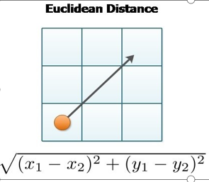
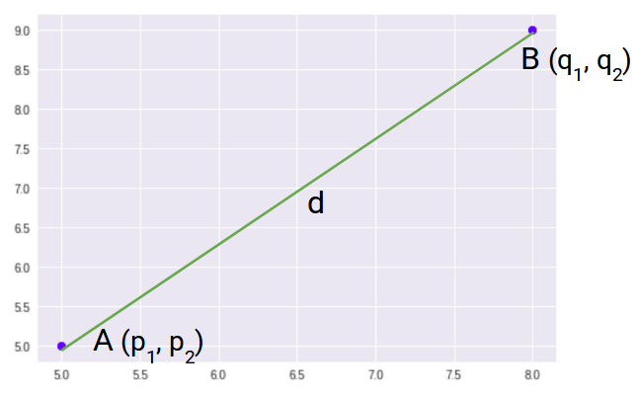

Distance or Geometric metrics
Euclidean metric
A measure of the distance between points plotted on a
Euclidean plane. It represents the shortest distance between two points. K-Means use this distance metric to measure the similarity between observations.
Here’s the formula for Euclidean Distance:

Slide 8
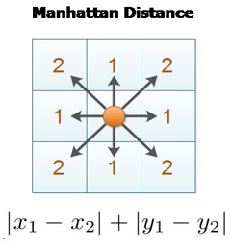
Manhattan metric
A measure of the distance between points where distance is calculated as the sum of the absolute value of the differences between two points’ Cartesian coordinates.
Minkowski distance metric
A generalization of the Euclidean and Manhattan distance
metrics. Quite often, these metrics can be used interchangeably.
Cosine similarity metric
The cosine metric measures the similarity of two data points based on their orientation, as determined by taking the cosine of the angle between them

Slide 9
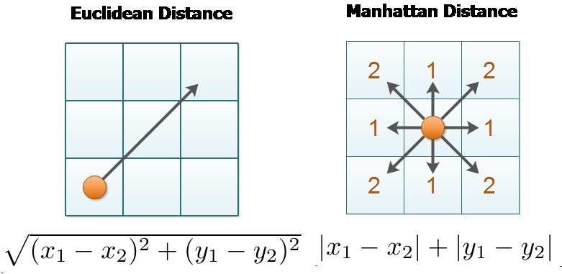

Slide 10
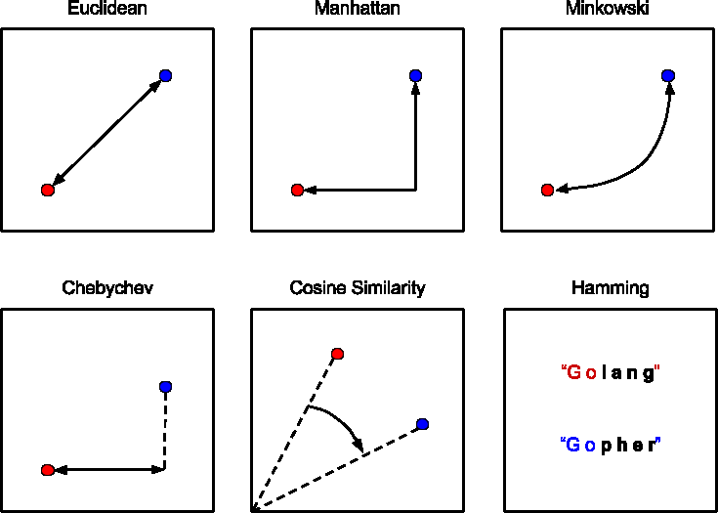

Slide 11
Jaccard distance metric
The Jaccard similarity index (sometimes called the Jaccard similarity coefficient) compares members for two sets to see which members are shared and which are distinct. It’s a measure of similarity for the two sets of data, with a range from 0% to 100%. The higher the percentage, the more similar the two populations. Although it’s easy to interpret, it is extremely sensitive to small samples sizes and may give erroneous results, especially with very small samples or data sets with missing observations.
The formula to find the Index is:
Jaccard Index = (the number in both sets) / (the number in either set) * 100
The same formula in notation is:
J(X,Y) = |X∩Y| / |X∪Y|

Slide 12
Two sets that share all members would be 100% similar. the closer to 100%, the more similarity (e.g. 90% is more similar than 89%). If they share no members, they are 0% similar. The midway point — 50% — means that the two sets share half of the members. A simple example using set notation: How similar are these two sets?
A = {0,1,2,5,6}
B = {0,2,3,4,5,7,9}
Solution: J(A,B) = |A∩B| / |A∪B| = |{0,2,5}| / |{0,1,2,3,4,5,6,7,9}| = 3/9 = 0.33.

Slide 13
Partitional Clustering
It is a type of clustering that divides the data into non-hierarchical groups. It is also known as the centroid-based method.
The dataset is divided into a set of k groups, where K is used to define the number of pre-defined groups.
The cluster center is created in such a way that the distance between the data points of one cluster is minimum as compared to another cluster centroid.

Slide 14
Partition-based Clustering:
K-Means: One of the most popular clustering algorithms, K-Means partitions the data into K clusters, where K is a user-specified parameter. It iteratively assigns each data point to the nearest cluster centroid and then recalculates the centroids based on the assigned points.
K-Medoids: Similar to K-Means, but instead of using centroids, K-Medoids chooses actual data points as cluster representatives (medoids). It is more robust to outliers than K-Means.

Slide 15
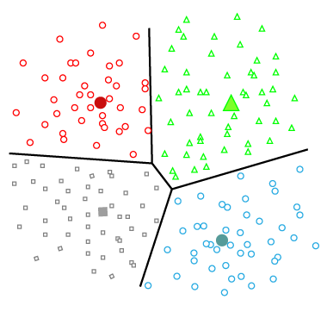
Centroid Based Clustering or Partitioning Clustering

Slide 16
Clustering algorithms
k-means
k-mediods
Kernel density estimation (KDE)
Hierarchical clustering algorithms
DBScan

Slide 17
K Means
K-Means Clustering is an Unsupervised Learning algorithm, which groups the unlabeled dataset into different clusters.
Here K defines the number of pre-defined clusters that need to be created in the process, as if K=2, there will be two clusters, and for K=3, there will be three clusters, and so on.
It is an iterative algorithm that divides the unlabeled dataset into k different clusters in such a way that each dataset belongs only one group that has similar properties.
It allows us to cluster the data into different groups and a convenient way to discover the categories of groups in the unlabeled dataset on its own without the need for any training.
It is a centroid-based algorithm, where each cluster is associated with a centroid. The main aim of this algorithm is to minimize the sum of distances between the data point and their corresponding clusters.

Slide 18
The algorithm takes the unlabeled dataset as input, divides the dataset into k-number of clusters, and repeats the process until it does not find the best clusters. The value of k should be predetermined in this algorithm.
The k-means clustering algorithm mainly performs two tasks:
Determines the best value for K center points or centroids by an iterative process.
Assigns each data point to its closest k-center. Those data points which are near to the particular k-center, create a cluster.
Hence each cluster has datapoints with some commonalities, and it is away from other clusters.

Slide 19
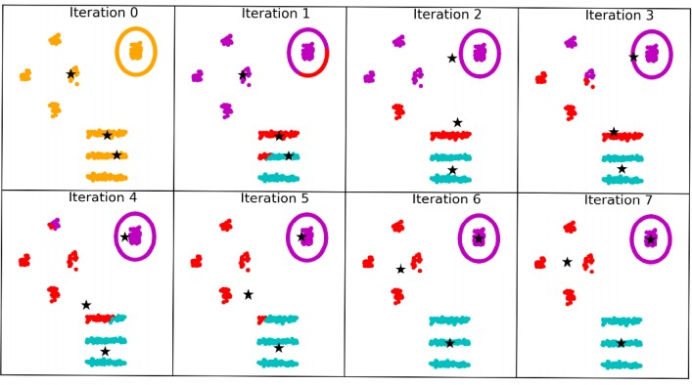
k-means in action

Slide 20
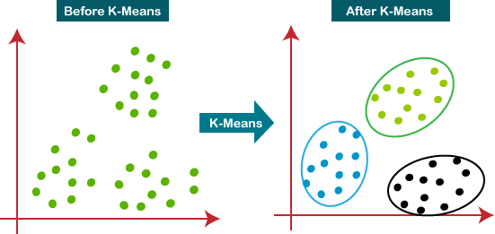

Slide 21
Steps to perform K Means
The working of the K-Means algorithm is explained in the below steps:
Step-1: Select the number K to decide the number of clusters.
Step-2: Select random K points or centroids. (It can be other from the input dataset).
Step-3: Assign each data point to their closest centroid, which will form the predefined K clusters.
Step-4: Calculate the variance and place a new centroid of each cluster.
Step-5: Repeat the third steps, which means reassign each datapoint to the new closest centroid of each cluster.
Step-6: If any reassignment occurs, then go to step-4 else go to FINISH.
Step-7: The model is ready.

Slide 22
Advantages of K-Means
1. It is relatively efficient with time complexity O(nkt) where-
•n = number of instances
•k = number of clusters
•t = number of iterations
2. It often terminates at local optimum.
Techniques such as Simulated Annealing or Genetic Algorithms may be used to find the global optimum.

Slide 23
Disadvantages of K-Means
•It requires to specify the number of clusters (k) in advance.
It can not handle noisy data and outliers.
It is not suitable to identify clusters with non-convex shapes.

Slide 24
K-Mediod
K Mediod is a clustering algorithm that groups similar data points together into cluster. It is variation of the K-Means algorithm and is used to partition a set of data points into K clusters, where K is a user-defined parameters.
The K- medioids algorithm works by selecting the K datapoints as the initial mediods , and then assigning each data point to the closest mediod.
The medoid is defined as the data points that is closest to the other data points in the cluster.

Slide 25
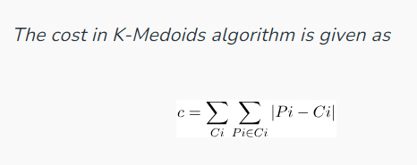
K-Medoids (also called Partitioning Around Medoid) algorithm was proposed in 1987 by Kaufman and Rousseeuw. A medoid can be defined as a point in the cluster, whose dissimilarities with all the other points in the cluster are minimum. The dissimilarity of the medoid(Ci) and object(Pi) is calculated by using
E = |Pi – Ci|

Slide 26
steps to perform K Mediod
Choose k number of random points from the data and assign these k points to k number of clusters. These are the initial medoids.
For all the remaining data points, calculate the distance from each medoid and assign it to the cluster with the nearest medoid.
Calculate the total cost (Sum of all the distances from all the data points to the medoids)
Select a random point as the new medoid and swap it with the previous medoid. Repeat 2 and 3 steps.
If the total cost of the new medoid is less than that of the previous medoid, make the new medoid permanent and repeat step 4.
If the total cost of the new medoid is greater than the cost of the previous medoid, undo the swap and repeat step 4.
The Repetitions have to continue until no change is encountered with new medoids to classify data points.

Slide 27
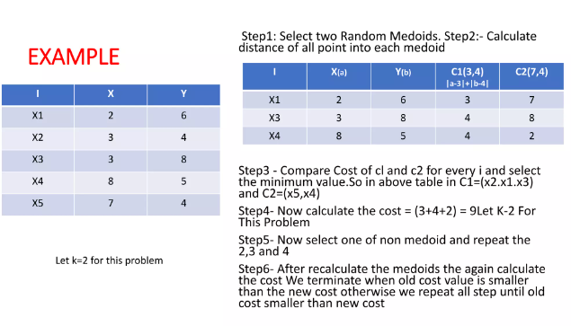

Slide 28
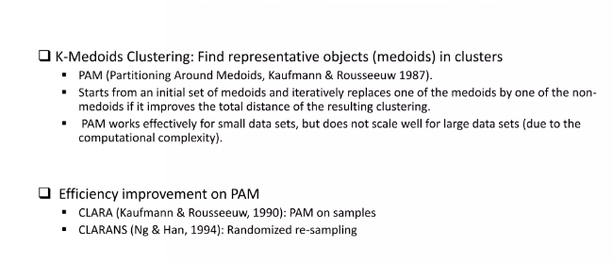

Slide 29
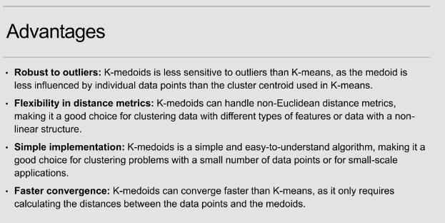

Slide 30
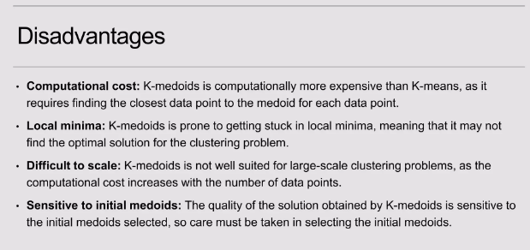

Slide 31
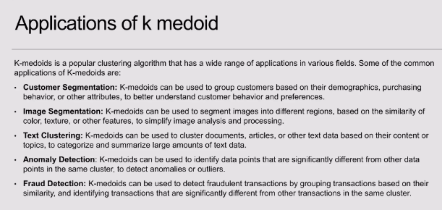

Slide 32
Density-Based Clustering
The density-based clustering method connects the highly-dense areas into clusters, and the arbitrarily shaped distributions are formed as long as the dense region can be connected. This algorithm does it by identifying different clusters in the dataset and connects the areas of high densities into clusters.
These algorithms can face difficulty in clustering the data points if the dataset has varying densities and high dimensions. But these methods have good accuracy and the ability to merge two clusters.
Example DBSCAN (Density-Based Spatial Clustering of Applications with Noise), OPTICS (Ordering Points to Identify Clustering Structure), etc.

Slide 33
Density-based Clustering:
DBSCAN (Density-Based Spatial Clustering of Applications with Noise): DBSCAN groups data points that are close to each other and have a sufficient number of neighbors within a specified radius. It can discover clusters of arbitrary shapes and is robust to noise and outliers.
OPTICS (Ordering Points to Identify the Clustering Structure): Similar to DBSCAN, OPTICS considers density-based connectivity but generates a reachability plot that allows for more flexible cluster extraction based on user-defined parameters.

Slide 34
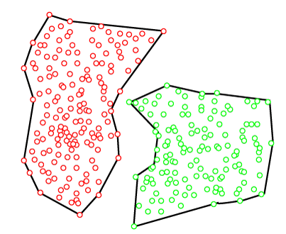
Density Based Clustering

Slide 35
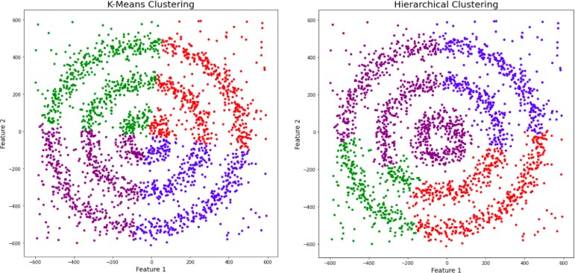
Why DBScan?

Slide 36
Why DBScan?
Partitioning methods (K-means, PAM clustering) and hierarchical clustering work for finding spherical-shaped clusters or convex clusters. In other words, they are suitable only for compact and well-separated clusters. Moreover, they are also severely affected by the presence of noise and outliers in the data.
Real life data may contain irregularities, like:
Clusters can be of arbitrary shape such as those shown in the figure below.
Data may contain noise.

Slide 37
DBSCAN algorithm requires two parameters:
eps : It defines the neighborhood around a data point i.e. if the distance between two points is lower or equal to ‘eps’ then they are considered neighbors. If the eps value is chosen too small then large part of the data will be considered as outliers. If it is chosen very large then the clusters will merge and the majority of the data points will be in the same clusters. One way to find the eps value is based on the k-distance graph.
MinPts: Minimum number of neighbors (data points) within eps radius. Larger the dataset, the larger value of MinPts must be chosen. As a general rule, the minimum MinPts can be derived from the number of dimensions D in the dataset as, MinPts >= D+1. The minimum value of MinPts must be chosen at least 3.

Slide 38
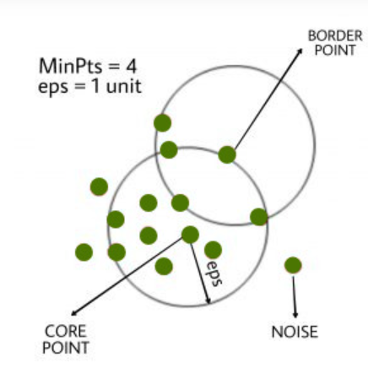
In this algorithm, we have 3 types of data points.
Core Point: A point is a core point if it has more than MinPts points within eps.
Border Point: A point which has fewer than MinPts within eps but it is in the neighborhood of a core point.
Noise or outlier: A point which is not a core point or border point.

Slide 39
Steps Used In DBSCAN Algorithm
Find all the neighbor points within eps and identify the core points or visited with more than MinPts neighbors.
For each core point if it is not already assigned to a cluster, create a new cluster.
Find recursively all its density-connected points and assign them to the same cluster as the core point. A point a and b are said to be density connected if there exists a point c which has a sufficient number of points in its neighbors and both points a and b are within the eps distance. This is a chaining process. So, if b is a neighbor of c, c is a neighbor of d, and d is a neighbor of e, which in turn is neighbor of a implying that b is a neighbor of a.
Iterate through the remaining unvisited points in the dataset. Those points that do not belong to any cluster are noise.

Slide 40
DBScan
Generally effective
Have two weaknesses
computationally expensive
We might have to provide the model with empirical parameter values for expected cluster size and cluster density

Slide 41
Hierarchical Clustering
The dataset is divided into clusters to create a tree-like structure, which is also called a dendrogram.
The observations or any number of clusters can be selected by cutting the tree at the correct level.
The most common example of this method is the Agglomerative Hierarchical algorithm.

Slide 42
Hierarchical Clustering:
Agglomerative Hierarchical Clustering: This method starts with each data point as its own cluster and iteratively merges the closest clusters until all data points belong to a single cluster. The result is a hierarchical tree-like structure called a dendrogram, which can be cut at different levels to obtain different clusterings.
Divisive Hierarchical Clustering: The opposite of agglomerative clustering, divisive hierarchical clustering starts with all data points in one cluster and recursively splits the clusters into smaller ones until each data point is its own cluster.

Slide 43
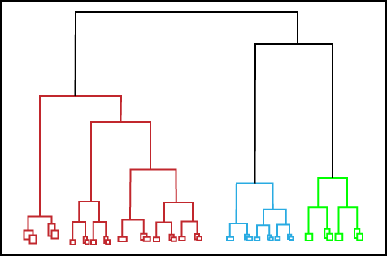
Hierarchical Clustering

Slide 44
Fuzzy Clustering
Fuzzy clustering is a type of soft method in which a data object may belong to more than one group or cluster.
Each dataset has a set of membership coefficients, which depend on the degree of membership to be in a cluster.
Fuzzy C-means algorithm is the example of this type of clustering; it is sometimes also known as the Fuzzy k-means algorithm.

Slide 45
When to use Clustering Algo
Know and understand the dataset you’re analyzing
You don’t have an exact idea of the nature of the subsets (clusters)
The subsets (clusters) are determined by only the single dataset you’re analyzing.
Your goal is to determine a model that describes the subsets in a single dataset and only this dataset.

Slide 46
Hierarchical clustering algorithms
Slower and more computationally expensive than k-means algorithms
Unsupervised clustering algorithm
Hierarchical algorithms are not subject to errors caused by center convergence
ideal machine learning solution to study or analyzing biological or environmental data

Slide 47
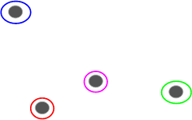
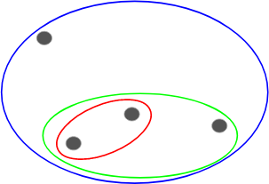
Types of Hierarchical Clustering
Two types
Agglomerative hierarchical clustering
2. Divisive Hierarchical clustering

Slide 48
How the algorithm works
It predicts groupings within a dataset by calculating the distance and generating a link between each singular observation and its nearest neighbor
The distance between observations is measured in three different ways: Euclidean, Manhattan, or Cosine
linkage is formed by three different methods: Ward, Complete, and Average

Slide 49
In the agglomerative hierarchical approach, we define each data point as a cluster and combine existing clusters at each step. Here are four different methods for this approach:
Single Linkage: In single linkage, we define the distance between two clusters as the minimum distance between any single data point in the first cluster and any single data point in the second cluster. On the basis of this definition of distance between clusters, at each stage of the process we combine the two clusters with the smallest single linkage distance.
Complete Linkage: In complete linkage, we define the distance between two clusters to be the maximum distance between any single data point in the first cluster and any single data point in the second cluster. On the basis of this definition of distance between clusters, at each stage of the process we combine the two clusters that have the smallestcomplete linkage distance.
Notes:
https://online.stat.psu.edu/stat505/lesson/14/14.4

Slide 50
Average Linkage: In average linkage, we define the distance between two clusters to be the average distance between data points in the first cluster and data points in the second cluster. On the basis of this definition of distance between clusters, at each stage of the process we combine the two clusters that have the smallest average linkage distance.
Centroid Method: In centroid method, the distance between two clusters is the distance between the two mean vectors of the clusters. At each stage of the process we combine the two clusters that have the smallest centroid distance.
Ward’s Method: This method does not directly define a measure of distance between two points or clusters. It is an ANOVA based approach. One-way univariate ANOVAs are done for each variable with groups defined by the clusters at that stage of the process. At each stage, two clusters merge that provide the smallest increase in the combined error sum of squares.[ just like agglomerative clustering]
Notes:
What is Analysis of Variance (ANOVA)? Analysis of Variance (ANOVA) is a statistical formula used to compare variances across the means (or average) of different groups. A range of scenarios use it to determine if there is any difference between the means of different groups.

Slide 51

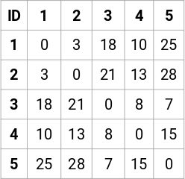
How the algorithm works

Slide 52
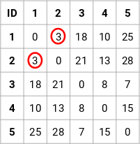
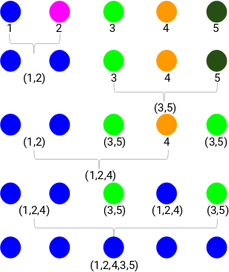
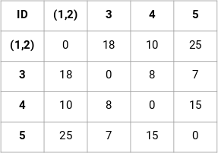

Slide 53
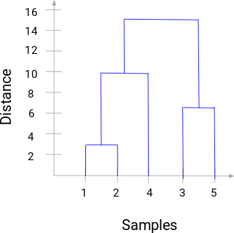
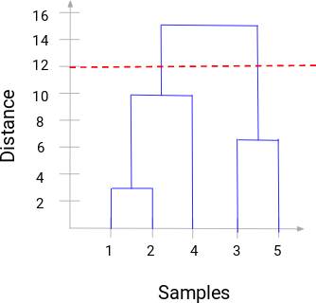
The number of clusters will be the number of vertical lines which
are being intersected by the line drawn using the threshold.
In the above example, since the red line intersects 2 vertical lines, we will have 2 clusters. One cluster will have a sample (1,2,4) and the other will have a sample (3,5).

Slide 54
Kernel Density Estimation
Kernel Density Estimation (KDE) is a non-parametric technique used to estimate the probability density function of a random variable.
While KDE itself isn't typically used directly for clustering, it can be a useful tool for identifying regions of high density, which can correspond to clusters in your data

Slide 55
Kernel density estimation (KDE)
kernel — a weighing function that is useful for quantifying density
place a kernel on each data point in the dataset and then summing the kernels to generate a kernel density estimate for the overall region.
Areas of greater point density will sum out with greater kernel density, and areas of lower point density will sum out with less kernel density.
don’t rely on cluster center placement
Notes:
https://medium.com/analytics-vidhya/kernel-density-estimation-kernel-construction-and-bandwidth-optimization-using-maximum-b1dfce127073

Slide 56
Working of KDE
Data Preparation:
Start with your dataset that you want to cluster. Ensure that it's appropriately preprocessed and scaled if needed.
Choose a Kernel:
Select a kernel function, such as Gaussian (normal), Epanechnikov, or others. The kernel function defines the shape of the density estimation around each data point.

Slide 57
Bandwidth Selection:
The bandwidth parameter determines the width of the kernel and significantly influences the result. A smaller bandwidth will lead to more emphasis on local details, potentially capturing smaller clusters, but being sensitive to noise. A larger bandwidth will lead to smoother estimations but might oversimplify the clusters. The choice of bandwidth is crucial and can impact the quality of cluster detection.
Apply KDE:
For each data point in your dataset, apply the selected kernel centered at that point, and then sum up the contributions from all data points. This effectively creates a smooth density estimation over your entire dataset.
Visualization:
Visualize the KDE using a heatmap or contour plot. The regions of higher density indicate potential cluster locations.

Slide 58
Peak Detection:
Identify peaks in the KDE. Peaks correspond to areas of higher density, and these regions could represent cluster centers.
Thresholding:
You can set a density threshold above which points are considered part of a cluster. This helps in excluding low-density noise points.
Cluster Assignment:
Assign data points to clusters based on their proximity to the identified peaks or local maxima in the KDE.

Slide 59
THANK YOU

